Slide 1

Obscene Content Blocker Using AI/ML
Teamsolo
Member 1-Kishan Payadi
Member 2-Amar Singh

Slide 2
Table Of Contents
2. Solution
Details
1. Problem
statement
3. Process
Flowchart
4. Use Cases
5. Future Scope
6. Business
Model
Canva

Slide 3

Problem Statement
Design and develop a technological solution for identifying and blocking any obscene media (image/video/audio) at the user’s end. The solution should be able to send alerts to the concerned nodal agency in case of the spread of such content. The solution may be in the form of a desktop/mobile application or a web browser plugin.

Slide 4
Solution Details
We have developed a sophisticated browser extension equipped with a machine learning model that effectively assesses the safety of URLs, with a primary focus on websites and popular video streaming platforms like YouTube. The extension requires essential information, including the email of the nodal agency and the system details of a user’s computer. This incorporation is integral to the extension's functionality, as it ensures a seamless and efficient process for alerting authorities when necessary.
For websites, our model employs a two-step process. Initially, it checks whether the provided URL corresponds to a known unsafe category, such as adult sites. If identified as unsafe, access is immediately denied. Otherwise, the model proceeds to scrape the content of the website. Based on this content analysis, the model predicts whether the given website contains explicit or unsafe material.
In the case of YouTube URLs, the model first checks for age restrictions. If the content is age-restricted, access is denied. If not, the model takes into account various parameters, including the YouTube video's description, title, and comments. Using these parameters, the model determines whether the content is not safe for work (NSFW).
Recognizing that machine learning models may not achieve perfect accuracy, we prioritize nodal agency in the decision-making process. Users are presented with two options: they can either return to the homepage or choose to access the website despite the model's prediction. If the user chooses the second option then a notification is automatically sent to a nodal agency, ensuring accountability and providing an avenue for users to clarify the nature of the content associated with the given URL. This approach aims to strike a balance between automated content assessment and user-driven accountability.
If a user uninstalls the extension, an automated notification will be promptly dispatched to the designated nodal agency, alerting them to the removal of the extension by the user.

Slide 5
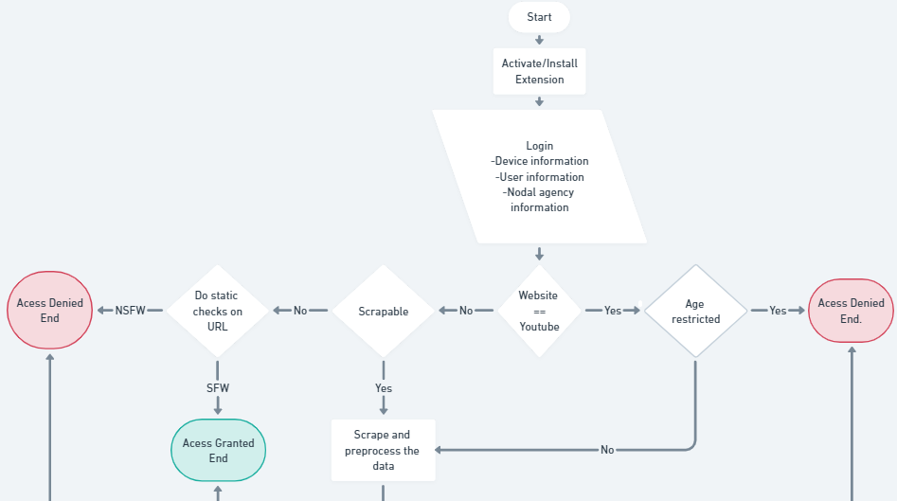
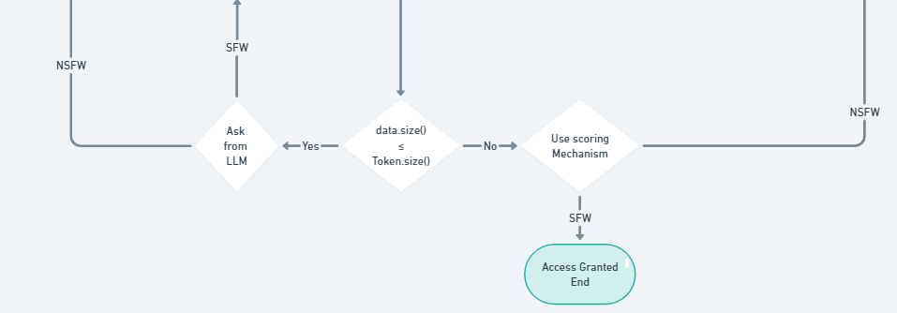
Process Flow chart

Slide 6
Use Cases
Parental Control:
Scenario: Parents want to ensure a safe online environment for their children.
Use Case: The browser extension helps parents filter and block explicit content, ensuring a child-friendly browsing experience.
Corporate Security:
Scenario: Organizations aim to maintain a safe and secure working environment.
Use Case: The extension helps organizations block access to inappropriate content, fostering a professional and secure workplace.
Public Spaces:
Scenario: Public places with shared computers (libraries, internet cafes) need to prevent access to explicit content.
Use Case: The extension helps maintain a safe browsing environment in public spaces, adhering to community standards.
Institutional Compliance:
Scenario: Organizations need to comply with regulations regarding inappropriate content.
Use Case: The extension helps organizations meet compliance standards by actively blocking and reporting explicit content.
Individual User Control:
Scenario: Users want to customize their online experience and avoid specific types of content.
Use Case: The extension allows users to define their content preferences, blocking or allowing websites based on their personal choices.

Slide 7
Future Scope
Advanced Machine Learning Models:
Explore the integration of more advanced machine learning models for content classification, such as deep learning models or transformer-based models like GPT (Generative Pre-trained Transformer) for enhanced accuracy.
Multimedia Content Analysis:
Extend the solution to include analysis of multimedia content, such as images and audio. Implementing image and audio recognition models can contribute to a more comprehensive content filtering system.
User Behavior Analysis:
Incorporate user behavior analysis to enhance content classification. Understanding patterns in user behavior can contribute to more accurate predictions and personalized content filtering.
Real-time Alerts and Reporting:
Implement real-time alerts for users and nodal agencies, enhancing the immediacy of response to potentially harmful content. Develop detailed reporting mechanisms for nodal agencies to facilitate timely intervention.
Collaboration with Online Platforms:
Collaborate with popular online platforms (YouTube, social media sites, etc.) to implement your solution at a larger scale. Integration with existing platforms can significantly impact the reach and effectiveness of the solution.

Slide 8
Business Model Canvas
Key partners
Educational institutions and organizations for collaborative implementations
Online platforms for potential integration partnerships
Cybersecurity firms for consultation and best practices
Key Activities
Software development and continuous updates
Machine learning model training and improvement
Marketing and promotional activities
User feedback analysis and model fine-tuning
Value propositions
Enhanced online safety through content filtering
Personalized content control and preferences
Compliance with regulatory standards
Early detection and reporting of inappropriate content
Continuous learning and improvement through user feedback
Customer Relationships
User onboarding tutorials and guides
Customer support for technical assistance
Regular updates on new features and improvements
Community forums for user engagement and feedback
Customer Segments
Parents and guardians
Educational institutions
Corporations and workplaces
Public spaces with shared computers
Individual users concerned about online safety
Key Resources
Data scientists for machine learning model enhancement
Marketing and sales team for promotion
Customer support team for user assistance
Channels
Direct distribution via web browser extension stores (Chrome Web Store etc.)
Collaboration with educational platforms and organizations
Online marketing and awareness campaigns and social media engagement
Cost Structures
Development and maintenance costs for the software
Machine learning model training and infrastructure costs
Marketing and promotional expenses
Customer support and community engagement costs
Revenue Streams
The freemium model with basic content blocking features available for free
Premium subscription for advanced features and personalization options
Partnerships and collaborations with educational institutions and organizations

Slide 9
Thank you!

